Slide 1


SUPERCHARGE YOUR WEB APPLICATION
WITH AZURE
#SCYWAWA

Slide 2


Introduction
Rick van den Bosch
@rickvdbosch
www.rickvandenbosch.net
Oscar van Tol
@oscarvantol
oscarvantol.wordpress.com

Slide 3
Todo list
Introduction
Agenda
Azure Functions, what’s up?
  Durable Functions
  Azure Functions 2.x (.NET Core)
Azure CDN
Azure Media Services
ASP.NET Core 2.1 SignalR
Azure SignalR Service
Azure Functions + SignalR Service

Slide 4
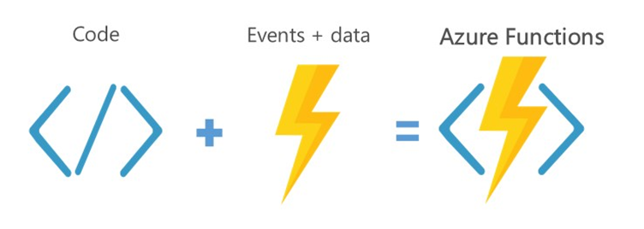
Azure Functions

Slide 5
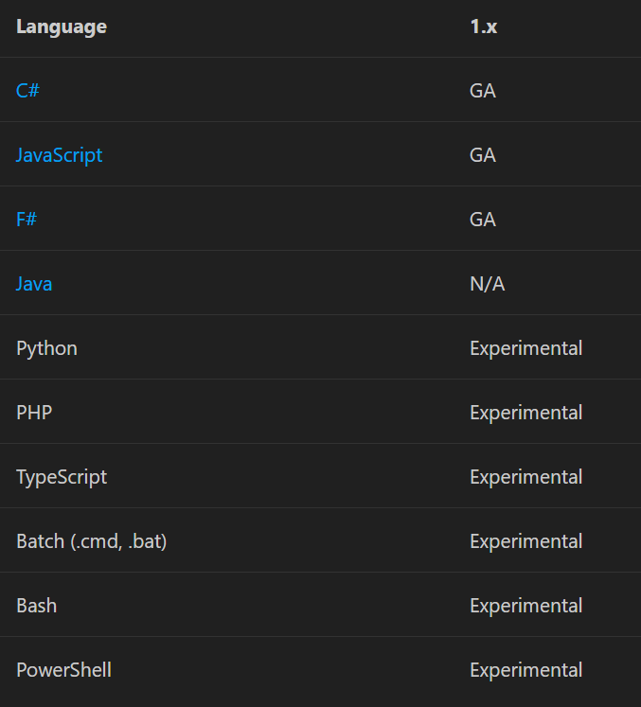
Features
Choice of language
Pay-per-use pricing model
Bring your own dependencies
Integrated security
Simplified integration
Flexible development
Open-source
Notes:
Choice of language - Write functions using your choice of C#, F#, or Javascript. See Supported languages for other options.
Pay-per-use pricing model - Pay only for the time spent running your code. See the Consumption hosting plan option in the pricing section.
Bring your own dependencies - Functions supports NuGet and NPM, so you can use your favorite libraries.
Integrated security - Protect HTTP-triggered functions with OAuth providers such as Azure Active Directory, Facebook, Google, Twitter, and Microsoft Account.
Simplified integration - Easily leverage Azure services and software-as-a-service (SaaS) offerings. See the integrations section for some examples.
Flexible development - Code your functions right in the portal or set up continuous integration and deploy your code through GitHub, Visual Studio Team Services, and other supported development tools.
Open-source - The Functions runtime is open-source and available on GitHub.

Slide 6
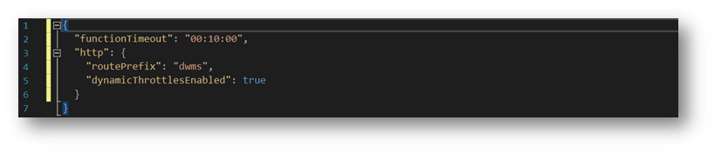
Limitations
Default time-out 5 minutes *
Can be increased to 10 minutes
Notes:
* on a consumptionplan

Slide 7
Azure Functions
{ Demo }

Slide 8
Durable Functions
Enables writing long-running,
stateful function orchestrations
in code in a serverless environment

Slide 9
Behind the scenes
Built on top of Durable Task Framework
Maintain State: Event Sourcing
Functions should be deterministic
Duration timers: max 7 days
Notes:
Durable Task framework extension for Azure Functions
Azure WebJobs -> Azure Functions
Durable Task Framework -> Durable Function

Slide 10
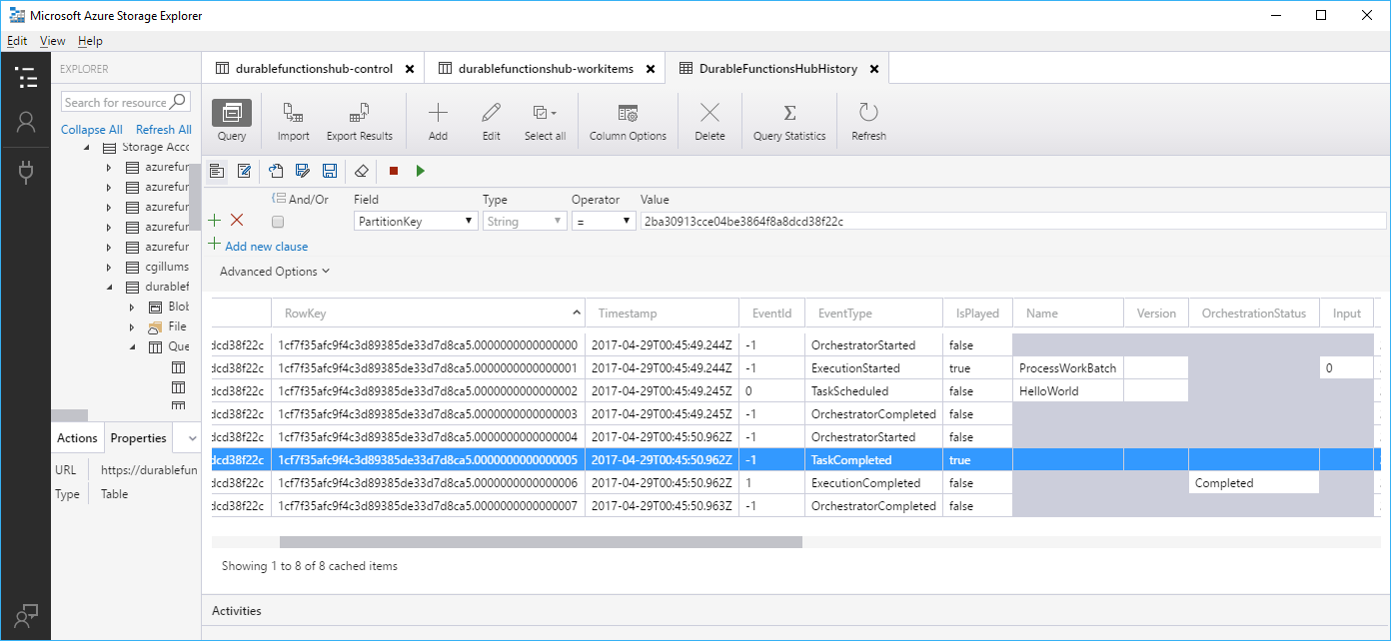
The process
Await yields control back to dispatcher
Dispatcher commits actions to storage (execution history)
Adds messages to a queue to schedule the work
Orchestrator can be unloaded
Orchestrator wakes up and re-executes the entire function
Check execution history for result:
  Result found: replay result
  No result found: do new work (or finish)

Slide 11
Patterns
Function chaining
Fan-out/fan-in
Async HTTP APIs
Monitoring
Human interaction

Slide 12
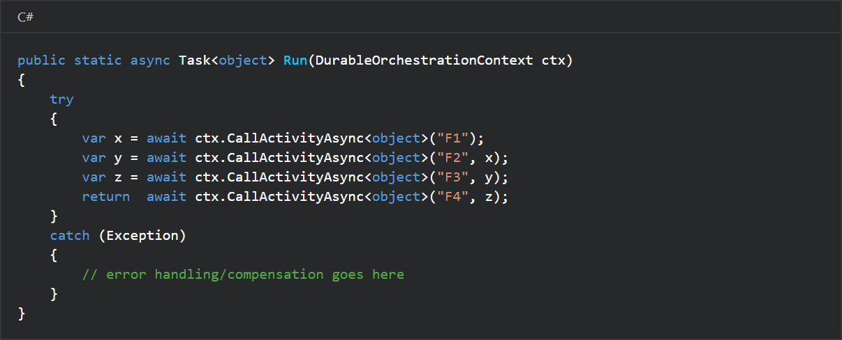
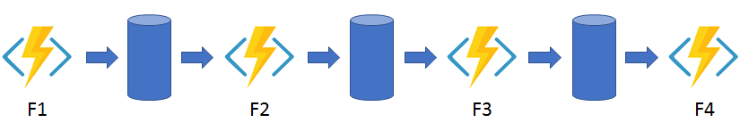
Durable Functions
Notes:
DurableOrchestrationContext provides methods for invoking other functions by name
Each time the code calls await, the Durable Functions framework checkpoints the progress of the current function instance
If the process or VM recycles midway through the execution, the function instance resumes from the previous await call.

Slide 13
Azure Functions 2.x
 | 1.x | 2.x
Status | Generally Available (GA) | Preview
Development | Portal & Windows | Cross platform
Languages (GA) | C#, JavaScript, F# | -
Languages (experimental) | Python, PHP, TypeScript, Batch, Bash, PowerShell | -
Languages (preview) | - | C#, JavaScript, F#, Java
Bindings |  | New binding extensibility model
Notes:
New extensibility model: support for 3rd party, decoupling of runtime and bindings, lighter execution environment
The experimental languages in 1.x don't scale well and don't support all bindings.

Slide 14
Azure CDN
The Azure Content Delivery Network

Slide 15
Azure CDN
Designed to send static files faster and more reliably
Using servers that are closest to the users
Dramatically increases speed and availability
Delivers significant user experience improvements
Verizon
Akamai
Microsoft

Slide 16
Azure CDN Propagation
It takes time for the registration to propagate
  Microsoft (Standard): usually completes in 10 minutes
  Akamai (Standard): usually completes within one minute
  Verizon (Standard): usually completes within 90 minutes
  Verizon (Premium): usually completes within 90 minutes

Slide 17
Azure CDN
{ Demo }

Slide 18
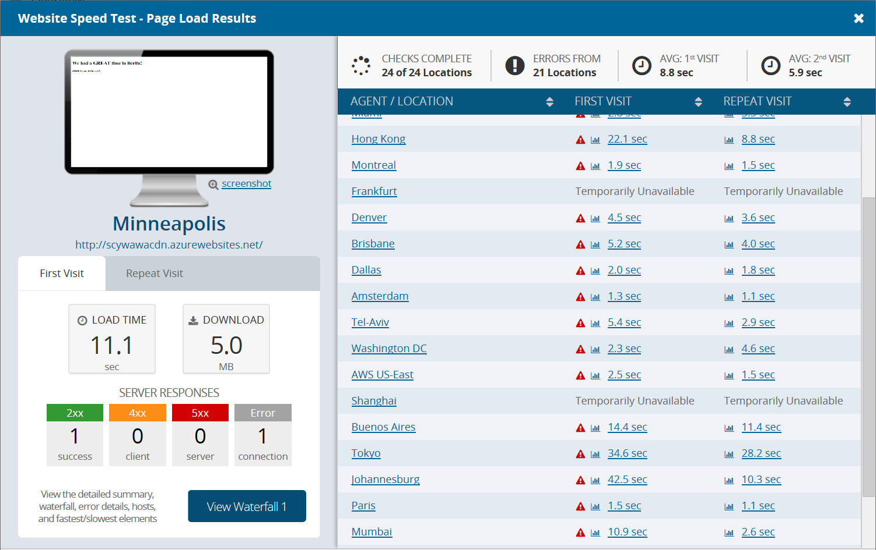
Test results
Without CDN

Slide 19
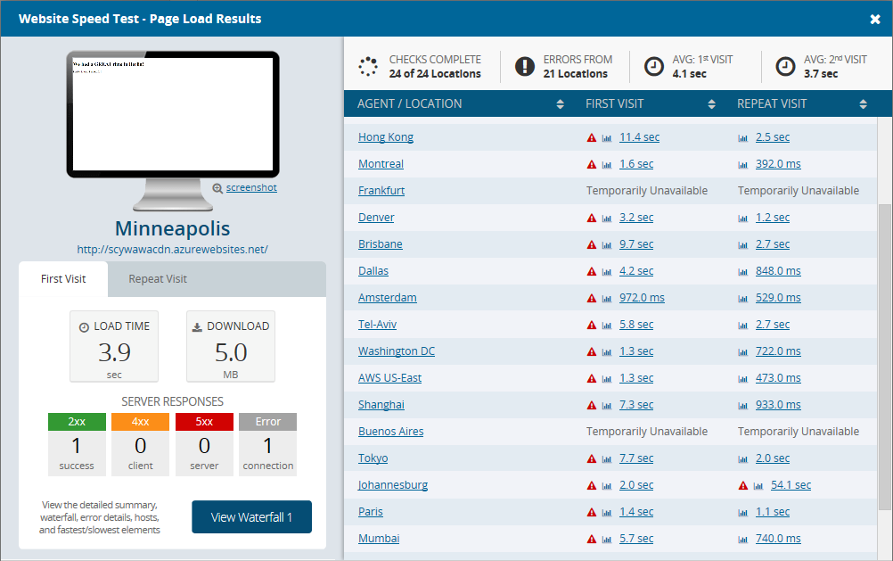
Test results
With CDN

Slide 20
ASP.NET Core 2.1 SignalR
`ASP.NET Core SignalR is a library that simplifies adding real-time web functionality to apps. Real-time web functionality enables server-side code to push content to clients instantly.`
Notes:
Good candidates for SignalR:
Apps that require high frequency updates from the server. Examples are gaming, social networks, voting, auction, maps, and GPS apps.
Dashboards and monitoring apps. Examples include company dashboards, instant sales updates, or travel alerts.
Collaborative apps. Whiteboard apps and team meeting software are examples of collaborative apps.
Apps that require notifications. Social networks, email, chat, games, travel alerts, and many other apps use notifications.

Slide 21
ASP.NET Core 2.1 SignalR
Server to client push: Global, Groups & Individual
Stream Results via "Channel" Class
TS/JS & .NET clients
Integration with ASP.Net core
  Dependency Injection
  Routing
  Auth
No more jQuery dependency ;)

Slide 22
ASP.NET Core 2.1 SignalR
Handles connection management automatically.
Enables broadcasting messages to all connected clients simultaneously. For example, a chat room.
Enables sending messages to specific clients or groups of clients.
Is open-sourced at 'MS-' GitHub.
Notes:
The connection between the client and server is persistent, unlike an HTTP connection.

Slide 23
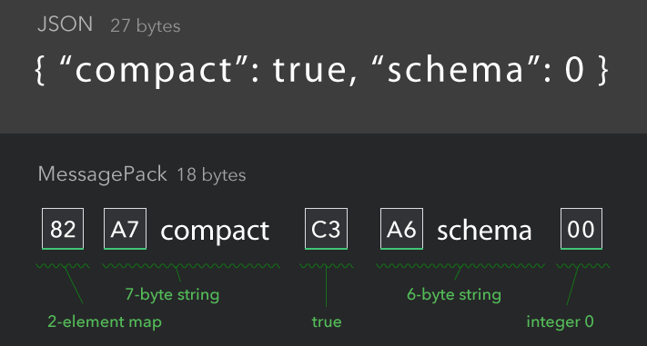
ASP.NET Core 2.1 SignalR
Transport, auto detect
  WebSockets
  Server Send Events
  Long Polling
Protocols
  Text based on JSON
  Binary based on MessagePack

Slide 24
Azure SignalR Service
`Because SignalR Service is a fully managed service, you can roll it out in a multiserver environment without worrying about hosting, scalability, load balancing, or authentication.`
Notes:
Good candidates for SignalR:
Apps that require high frequency updates from the server. Examples are gaming, social networks, voting, auction, maps, and GPS apps.
Dashboards and monitoring apps. Examples include company dashboards, instant sales updates, or travel alerts.
Collaborative apps. Whiteboard apps and team meeting software are examples of collaborative apps.
Apps that require notifications. Social networks, email, chat, games, travel alerts, and many other apps use notifications.

Slide 25
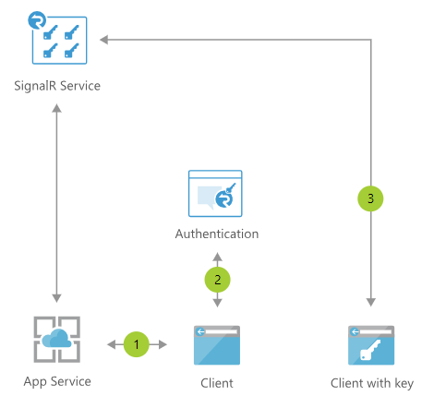
Azure SignalR Service
Notes:
1 Web chat app connects to SignalR Service and receives token
2 User logs into app with multi-factor authentication; if passed, SignalR endpoint and bearer token returned
3 User connects to the SignalR Service with endpoint and token

Slide 26
ASP.NET Core 2.1 SignalR
Azure SignalR Service
{ Demo }

Slide 27
ASP.NET Core 2.1 SignalR
ASP.Net Core 2.1 App
Angular app
Create solution
services.AddSignalR().AddAzureSignalR();
app.UseFileServer(); //for hosting angular in wwwroot
app.UseAzureSignalR(routes=> { routes.MapHub<HubClass:Hub>("/routeToHub"); });
Create HubClass: Hub
Add Methods to HubClass
Create app with cli: "ng new appname"
npm install @aspnet/signalr
let hubConn = new HubConnectionBuilder().withUrl("/routeToHub").build();
hubConn.start();
hubConn.on("sendmessage", (person: string, message: string) => { });
hubConn.send("methodInHub", "param1", "p2"…);

Slide 28
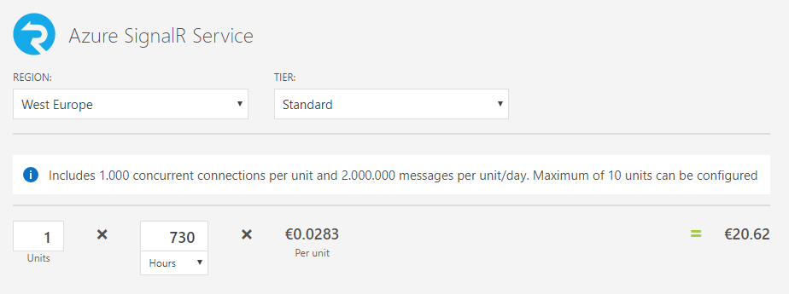
Azure SignalR Service - Preview
Current regions: West Europe, Southeast Azia, East US, West US
Dev/Test: Free

Slide 29
Azure SignalR Service + Azure Functions
Supported scenarios
Allow clients to serverlessly connect to a SignalR Service hub without requiring an ASP.NET Core backend
Use Azure Functions (any language supported by V2) to broadcast messages to all clients connected to a SignalR Service hub
Example scenarios include: broadcast messages to a SignalR Service hub on HTTP requests and events from Cosmos DB change feed, Event Hub, Event Grid, etc
Current limitations
Only supports broadcasting at this time, cannot invoke methods on a subset of connections, users, or groups
Functions cannot be triggered by client invocation of server methods (clients need to call an HTTP endpoint or post messages to an Event Grid, etc, to trigger a function)
GitHub: anthonychu/AzureAdvocates.WebJobs.Extensions.SignalRService

Slide 30
Azure SignalR Service + Azure Functions
{ Demo }

Slide 31
Azure Media Services

Slide 32
Azure Media Services
Supports most popular screens and devices
Automatically chooses the best playback format
Easily integrates into web and app solutions
Lets you use familiar JavaScript API development
Gives you integrated content protection
Integrates with CDN

Slide 33
Azure Media Services
{ Demo }

Slide 34
TIP
Kraken.io
Image Optimizer (VS Tool, Mads Kristensen)

Slide 35
Resources
https://github.com/oscarvantol/scywawa
https://github.com/anthonychu/AzureAdvocates.WebJobs.Extensions.SignalRService
http://azureinteractives.azurewebsites.net/CloudDesignPatterns/

