Slide 1

Azure Active Directory -
Business 2 Consumer
Jurgen van den Broek
Cloud consultant

Slide 2
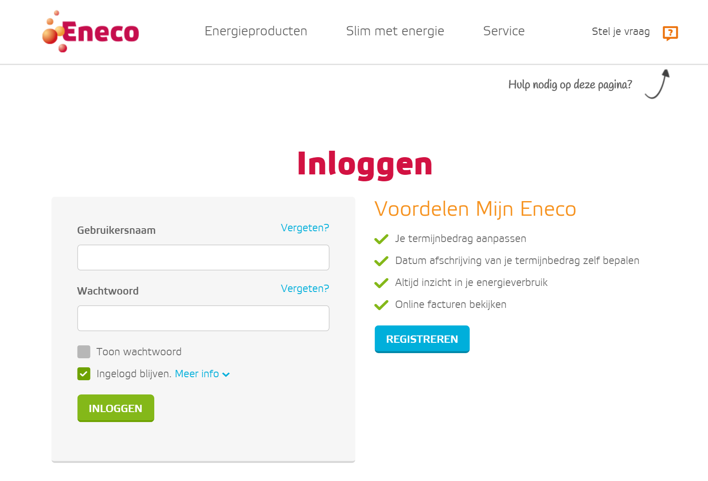
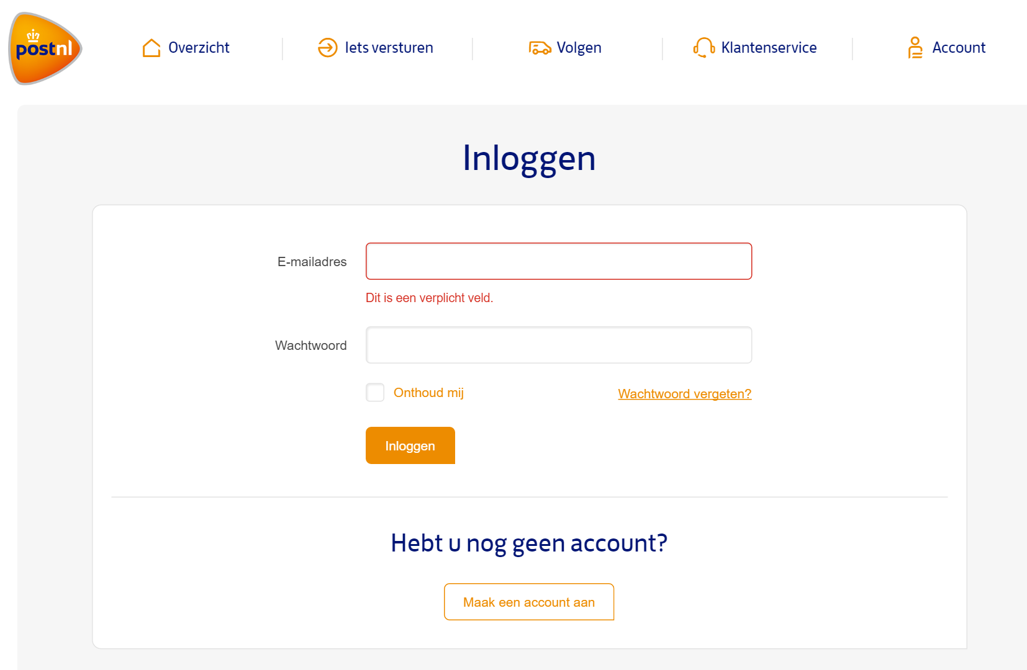
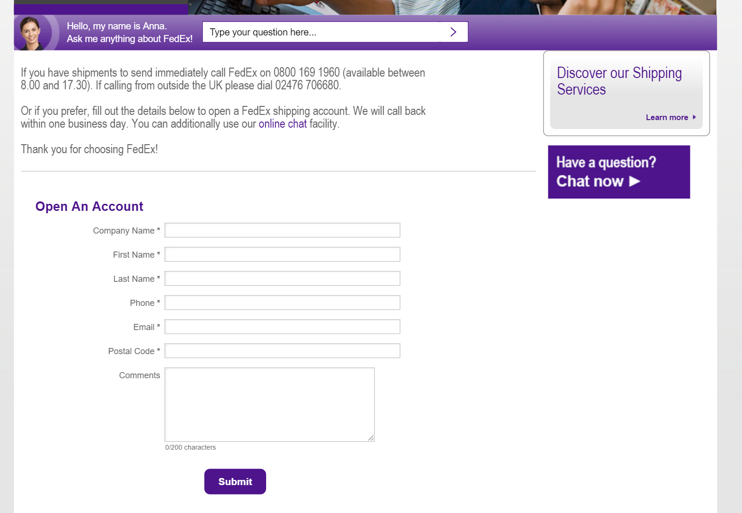
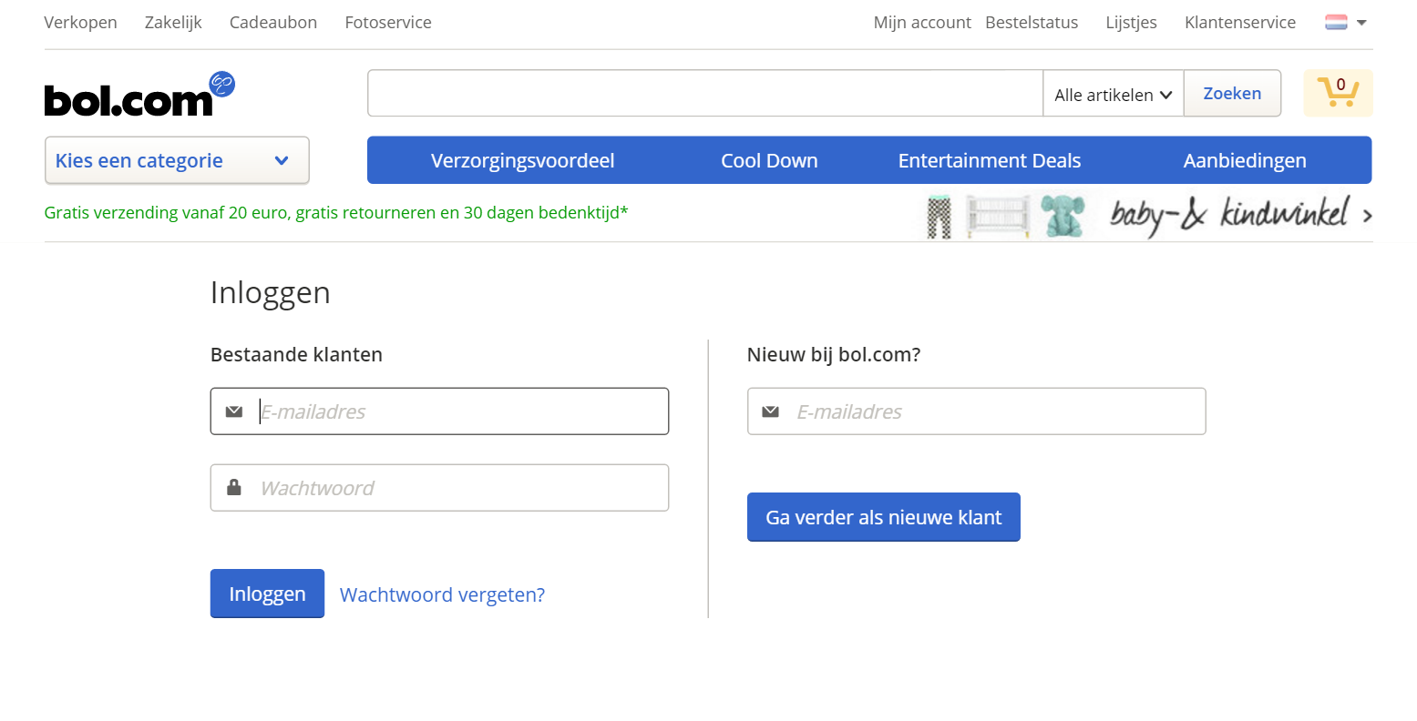
Customer identity cases

Slide 3



Technical solution so far
Authentication
  Local authentication mechanisms

Slide 4



Technical solution so far
Authentication
  Local authentication mechanisms
  Direct Social IdP integration

Slide 5




Technical solution so far
Authentication
  Local authentication mechanisms
  Direct Social IdP integration
  Active Directory Federation Server (ADFS)
  infrastructure solutions

Slide 6


Technical solution so far
Authentication
  Local authentication mechanisms
  Direct Social IdP integration
  Active Directory Federation Server (ADFS)
  infrastructure solutions
Identity management
  Local user store

Slide 7
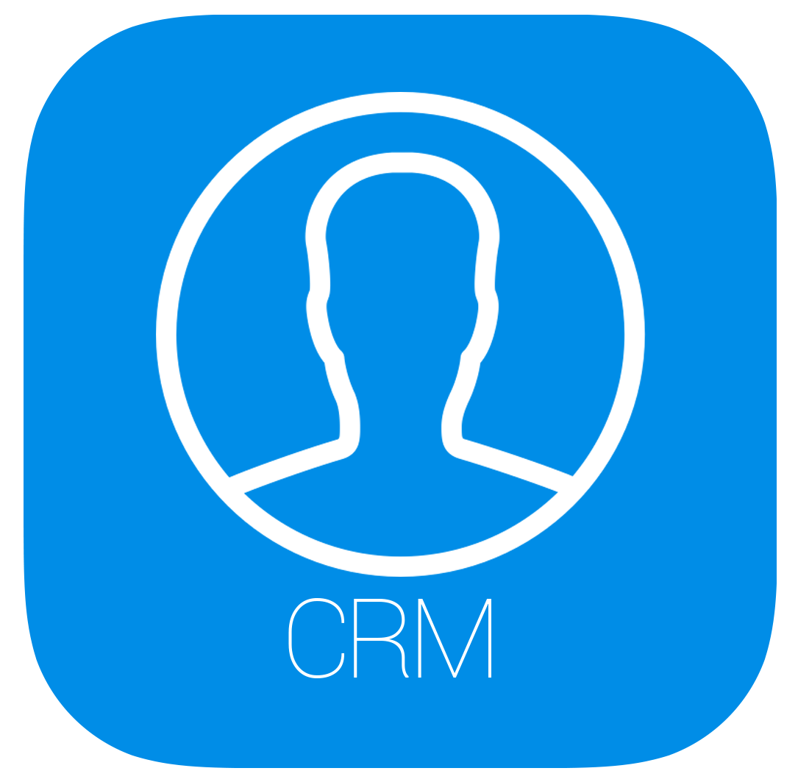
Technical solution so far
Authentication
  Local authentication mechanisms
  Direct Social IdP integration
  Active Directory Federation Server (ADFS)
  infrastructure solutions
Identity management
  Local user store
  CRM Integration

Slide 8
Technical solution so far
Authentication
  Local authentication mechanisms
  Direct Social IdP integration
  Active Directory Federation Server (ADFS)
  infrastructure solutions
Identity management
  Local user store
  CRM Integration
Self Service?

Slide 9


What’s new?
  Customizable configuration per Application
  (including branding)
  Single Sign On
  Registration functionality
  Social Identity Providers
  Azure AD B2C

Slide 10
Comparing
Azure Active Directory
  Identity Provider
  Focus on self-service
  Enterprise identities
  HR
  Auto-provisioned
  License per user
Azure Active Directory B2C
  Identity Provider
  Focus on self-service
  Customer identities
  CRM
  Self-registration
  Price per user / authentication

Slide 11

What’s on the menu
Demo environment
Authentication / Registration
Social Identity Providers
Attributes and Claims
Branding
Typical B2C scenarios
  Azure AD B2C

Slide 12

Demo

Slide 13
Authentication & Registration

Slide 14
Authentication & Registration
Protocols & tokens
  OpenID Connect and OAuth 2.0
  JWT tokens
Policies
  Sign-in policy
  Sign-up policy
  Sign-up or sign-in policy
  Profile editing policy
  Password reset policy
  Identity Provider
  Attributes and Claims
  Token and Session
  Branding
  Azure AD B2C

Slide 15
Demo

Slide 16
Social Identity Providers

Slide 17


Social Identity Providers
Microsoft
Amazon
Google
Facebook
LinkedIn
..?
  Azure AD B2C

Slide 18
Demo

Slide 19
Attributes and Claims

Slide 20
Attributes and Claims
Attributes
  Custom attributes
City
Country
Email
Given Name
Surname
….
  Azure AD B2C

Slide 21


Attributes and Claims
Attributes
  Custom attributes
Claims
  Claim handling
  Claims including custom attributes
  User
  Azure AD B2C

Slide 22
Demo

Slide 23
Branding

Slide 24
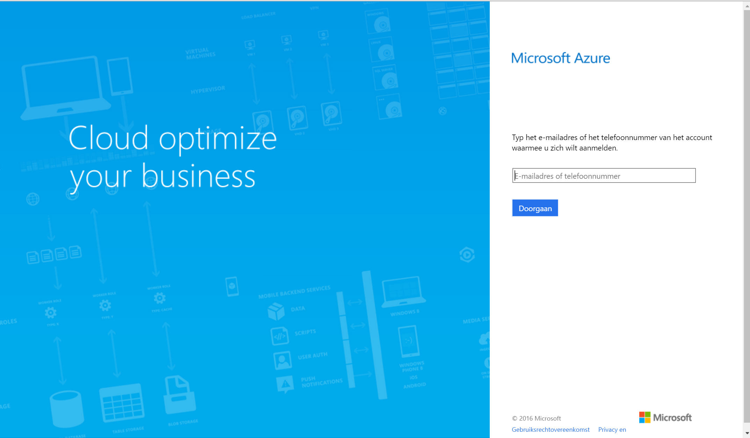
Branding

Slide 25
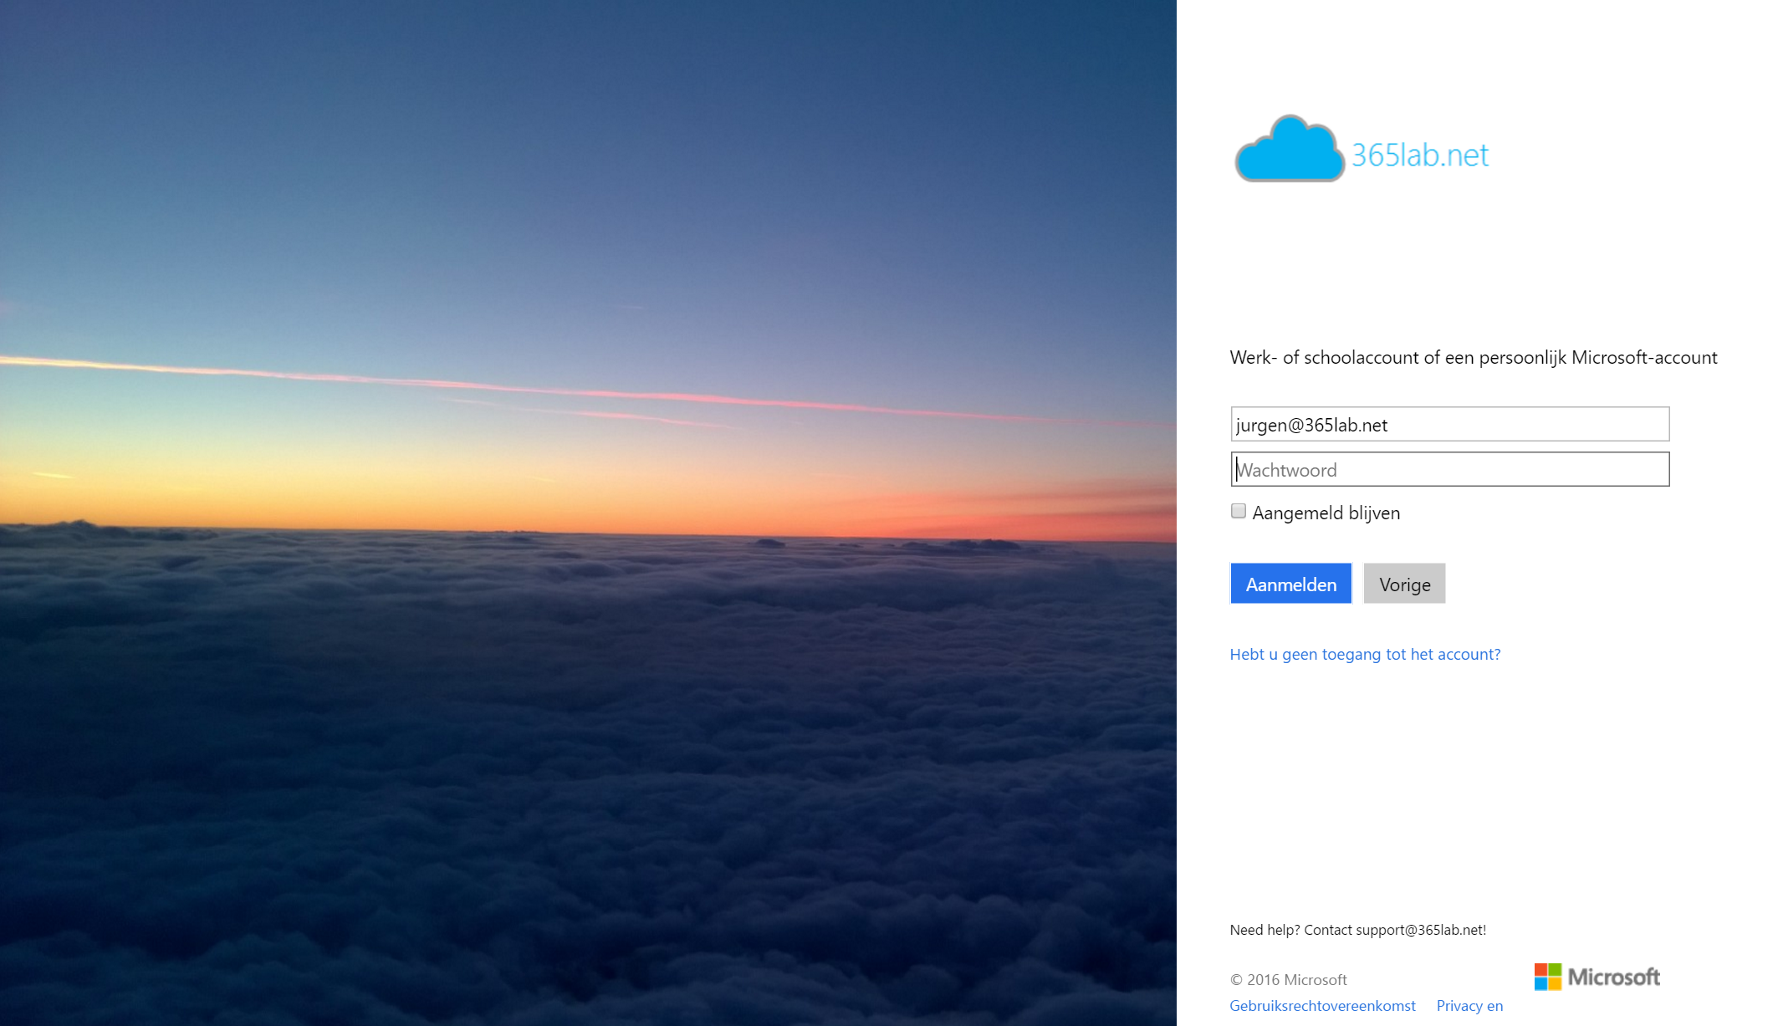
Branding

Slide 26
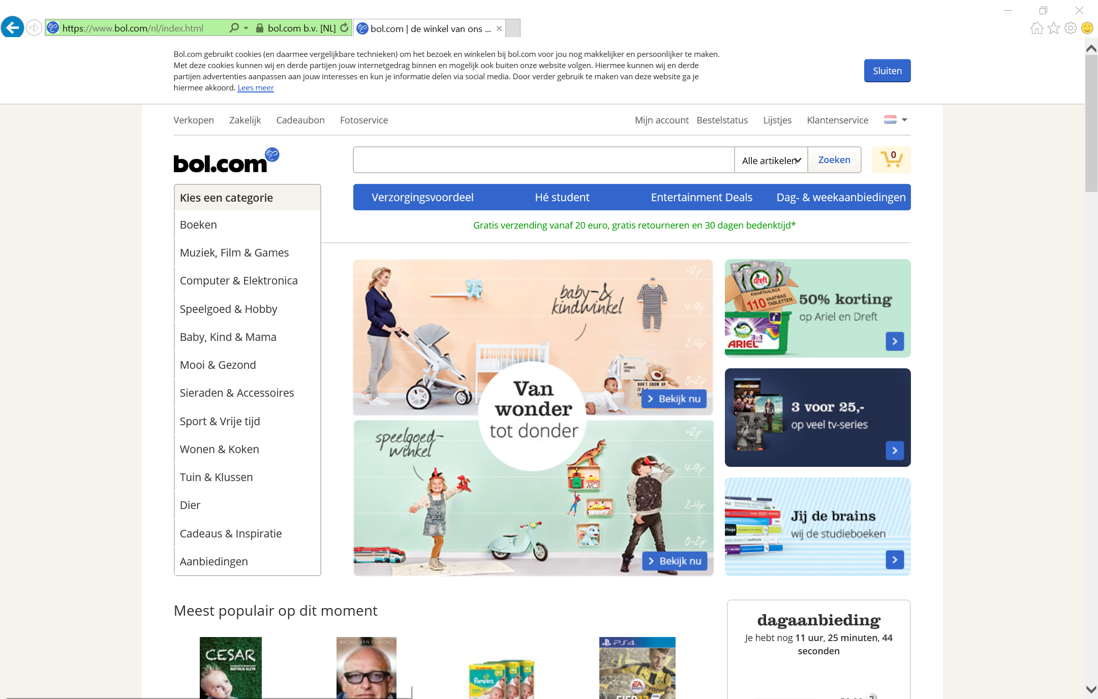
Branding

Slide 27
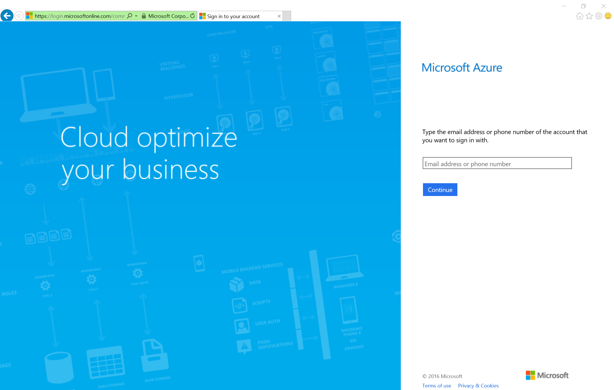
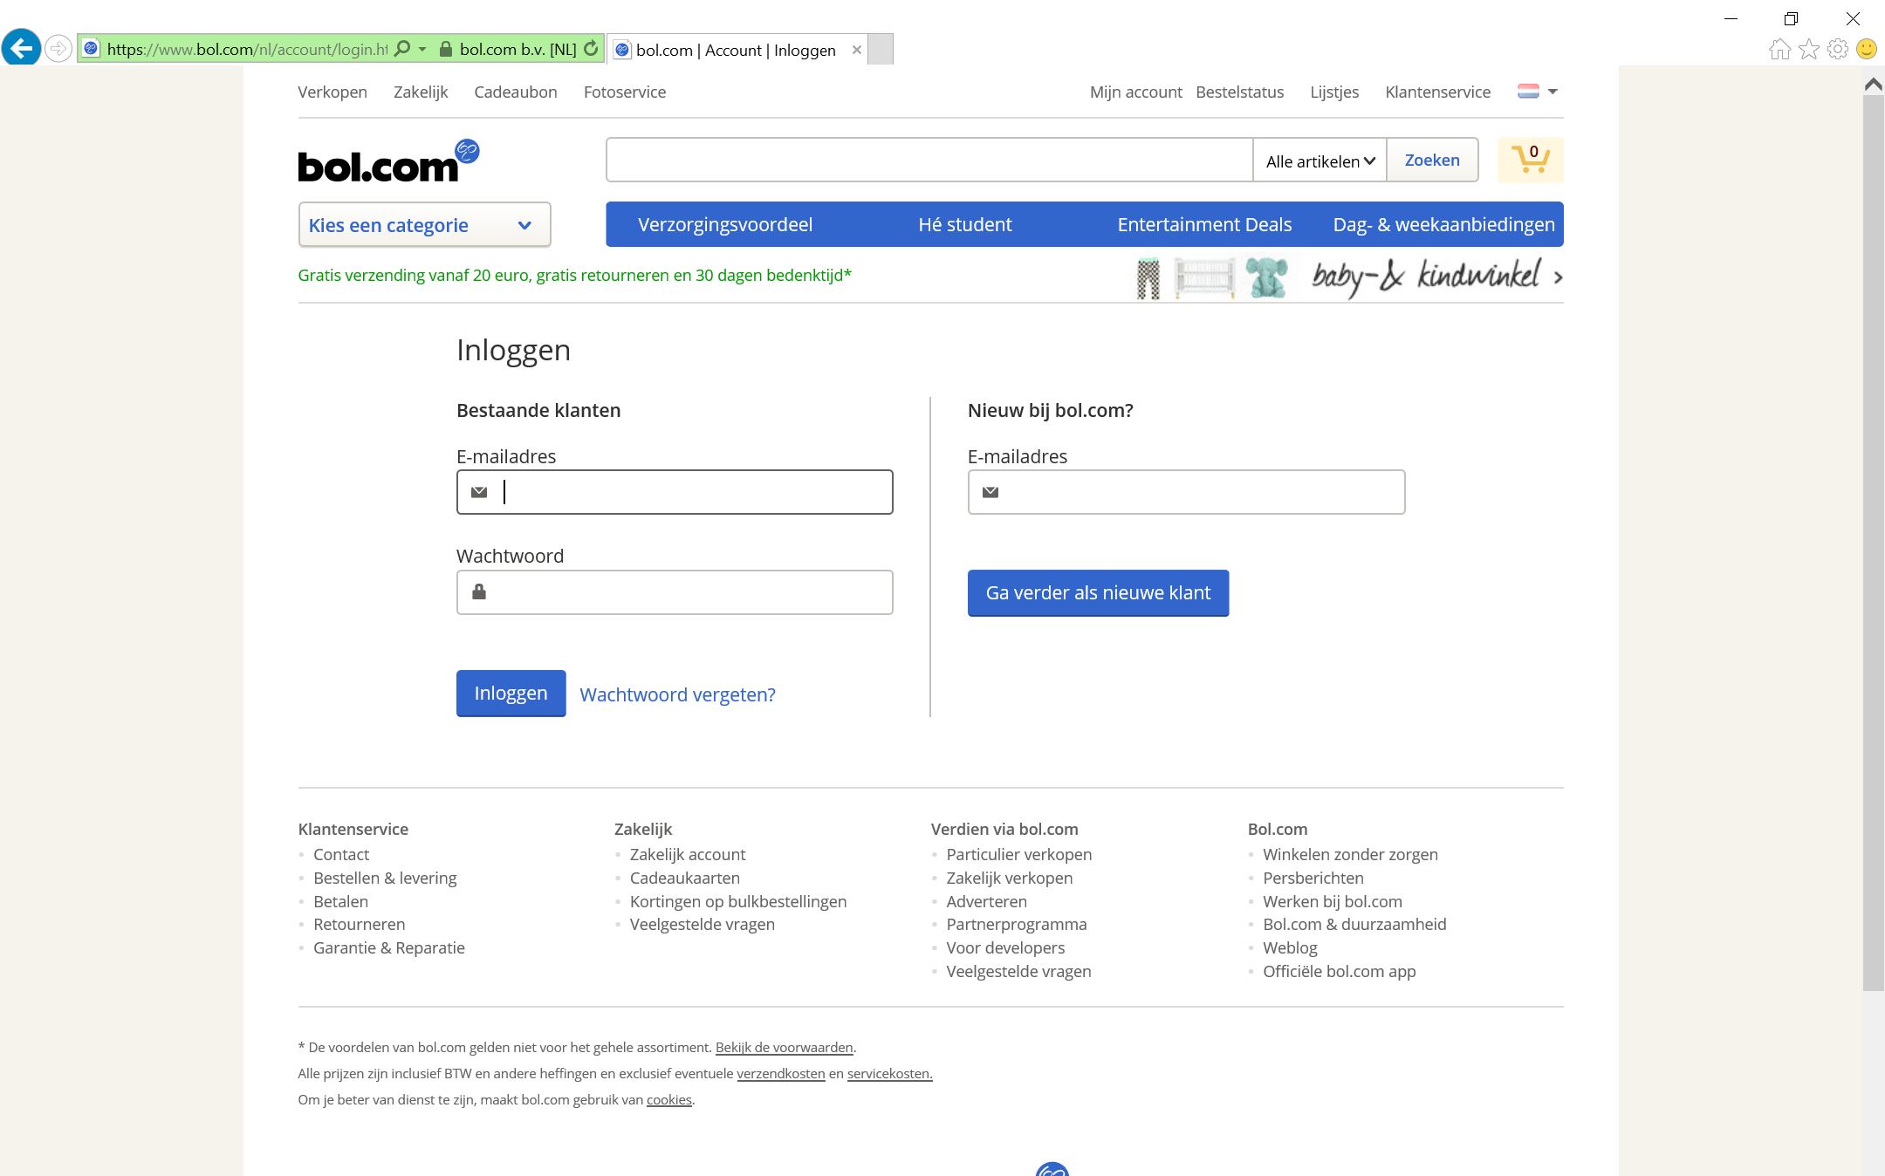
Branding

Slide 28
Demo

Slide 29
Typical B2C scenarios

Slide 30
Typical B2C scenarios
Identity Management
  Identity versus application data
  Identity
  Azure AD B2C
  Application
  Graph API

Slide 31
Typical B2C scenarios
Identity Management
  Identity versus application data
  ID mapping
  Identity
  Azure AD B2C
  Application
  ID Mapping

Slide 32
Typical B2C scenarios
Identity Management
  Identity versus application data
  ID mapping
  Registration
  User
  Azure AD B2C

Slide 33
Typical B2C scenarios
Identity Management
  Identity versus application data
  ID mapping
  Registration
Business to Business (B2B)
  User
  Identity
  Administrator
  Azure AD B2C
  Application

Slide 34
B2C or B2B?
B2B
B2C
What is it for?
IT Pros providing access to their organization’s data and apps to a partner organization.
Developers working on consumer- & citizen facing mobile & web apps.
Who is it for?
Partner users acting “on behalf of”, as representative or employees of their organizations.
Consumers and citizens acting as themselves.
Manageability
Govern Access: Access review, email verification, allow list / deny list.
Self-service: Users manage their own profiles.
Discoverability
Partner users are discoverable and can see other users from their own organization.
Consumers and citizens are invisible to other consumers and citizens. Privacy and consent are paramount.

Slide 35
Roadmap
Custom URL’s
Localization support
Web API’s
SAML / WS-Fed support

Slide 36
@juvdbroek
www.identityandcloud.com

