Slide 1
Reference case : Real time passenger counting Virtual train: combine all information on assets
9 januari 2013 Riccardo Becker

Slide 2
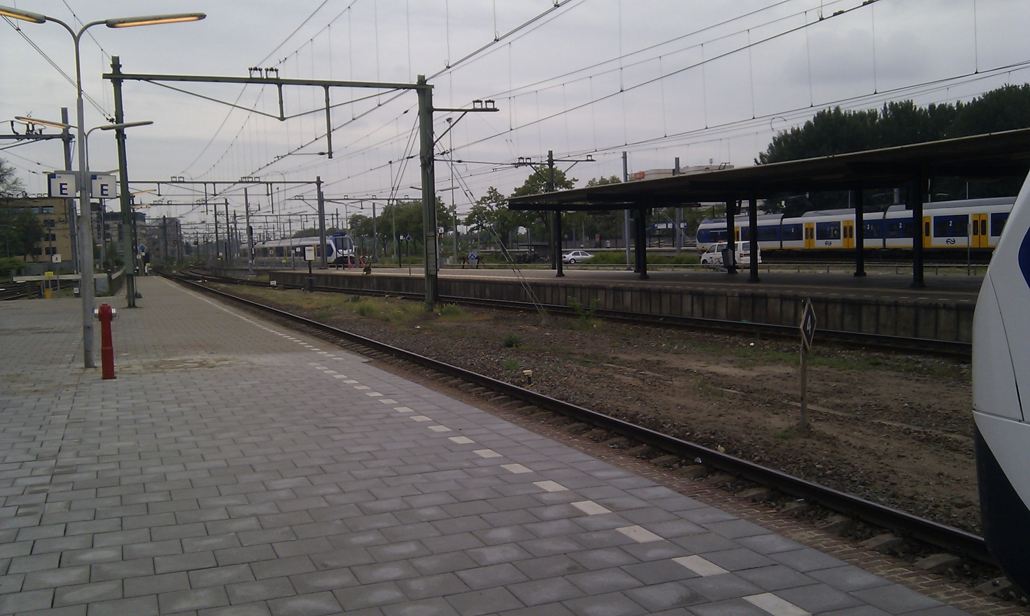
Who dares to wait for the train here …
Notes:
Waar stopt de trein precies? Hoeveel treinstellen zijn er? Waar is de eerste klas?

Slide 3
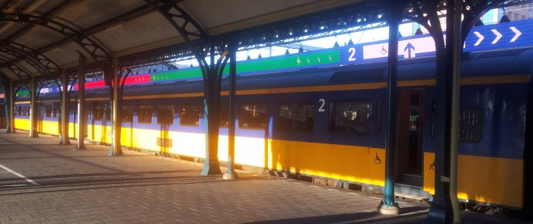
...and who dares to wait here?
Notes:
Exact weten waar in te stappen op basis van drukte en/of specifieke wensen zoals fiets, rolstoelingang, stiltecoupés of in welke klas.
LED display van 180 m tijdelijk aanwezig geweest in Den Bosch

Slide 4
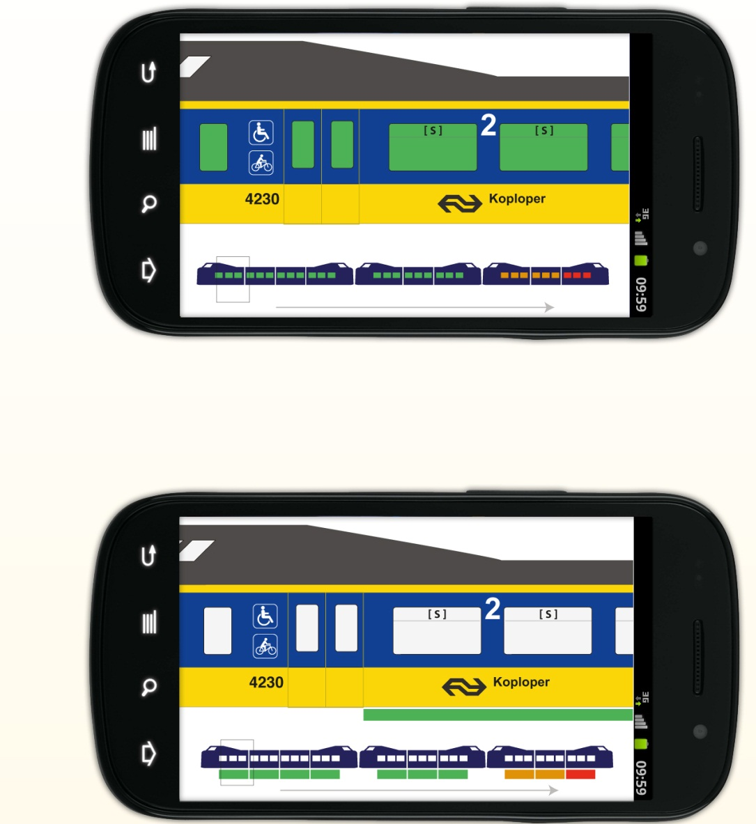
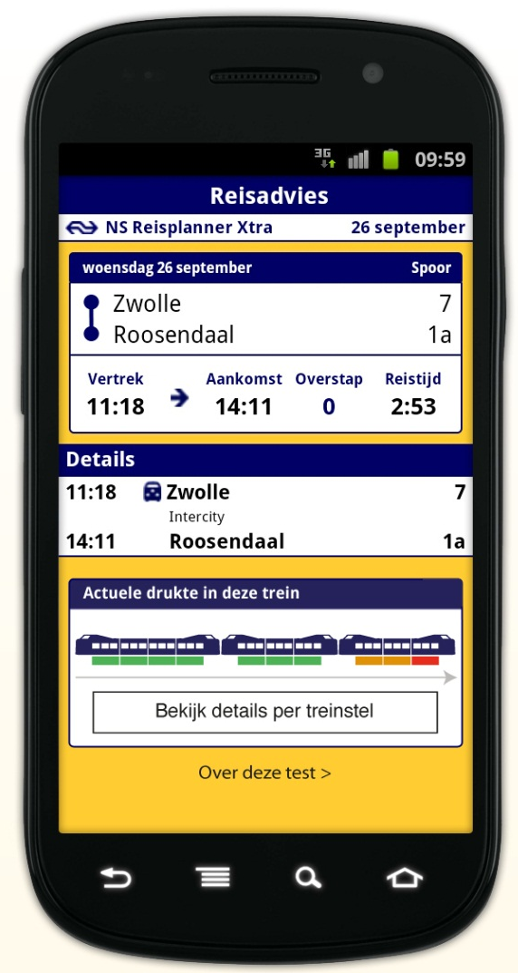
...or use this as your navigator?
Notes:
Niet overal hangt een LED scherm...iNStApp

Slide 5
Pilot Cognos
First talks during summer 2012
Scope 11 trainsets on the Zwolle-Roosendaal traject
Gain experience with :
the sensors, how good are they?
Progress Apama (currently Software AG) as the strategic choice of NS for complex event processing, does it add value?
Windows Azure, first use in Enterprise environment and how can we benefit from it?

Slide 6
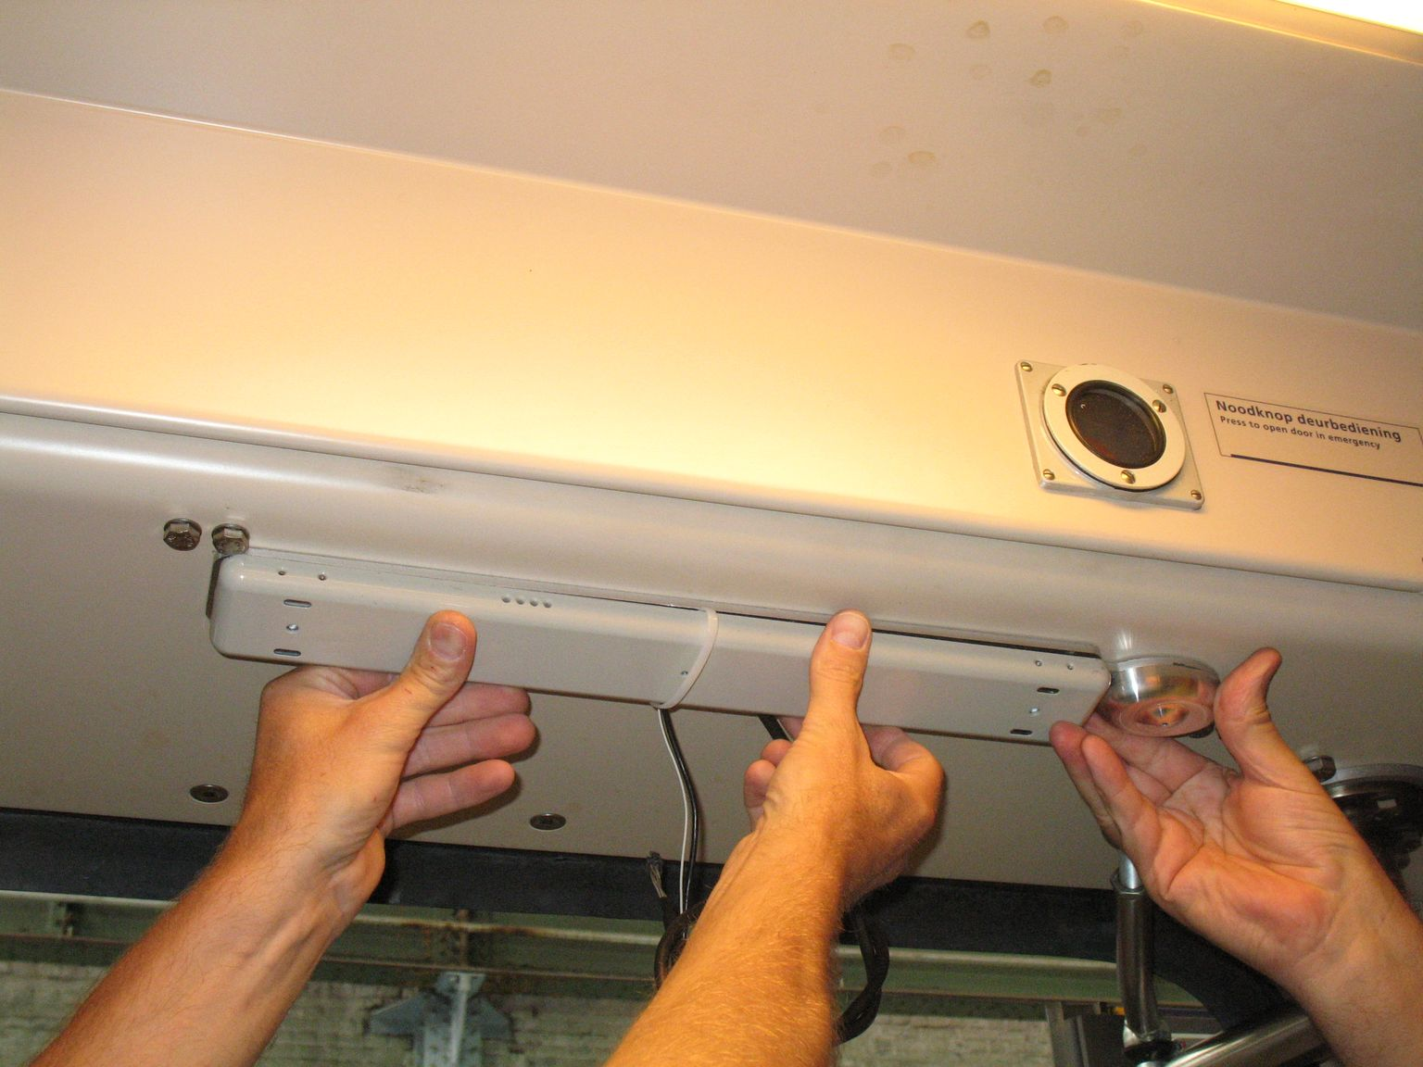
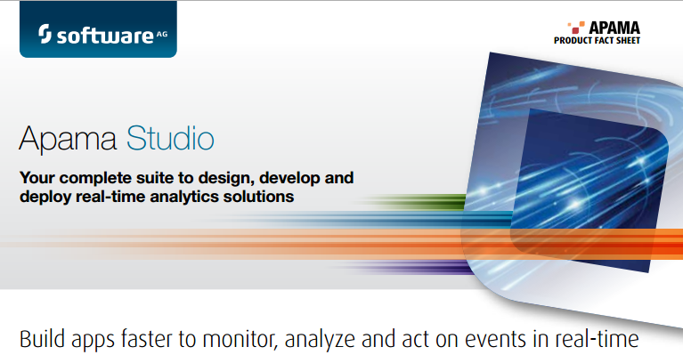
Cognos components
+
+
= COGNOS

Slide 7
Cognos ICT
Functional setup
Driving direction
Train set
carriage
carriage
carriage
Sensor
Sensor
Sensor
count application
On-board
ICT platform
Virtual train train-side
Actual passenger count after each stop per compartment
NS-API
Travel information
Virtual train
Wayside system
Real-time travel information
- link trips with train sets
- Combine trainsets into train view
- Orientation train vs platform (polarity/direction)
- Apama complex event processing
- REST interface for App
App

Slide 8
Virtual train concept
Is a digital representation of the reality outside
Combines events and information from various sources into a coherent view on the status of the train(set)
Provides an enterprise service to all applications in need of train set information
Possible applications:
Improved location information
Passenger counting including train configuration
Technical status of train sets
Which staff (which phone number), which disabled passenger, rail catering, cleaning needed,
Etc.

Slide 9
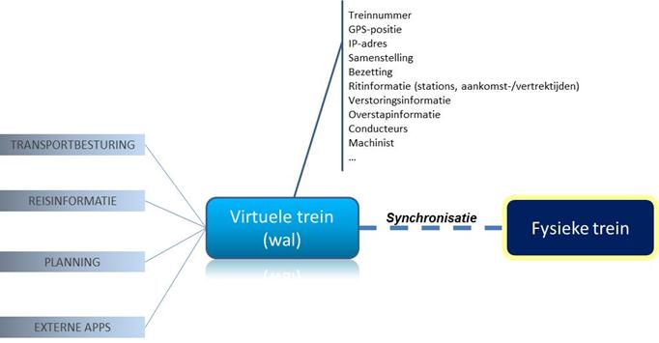
Concept Virtual Train

Slide 10
Virtual train cloud service technical setup
Deployed on Windows Azure
Apama Complex Event Processing middleware to process all incoming events from the train sets
Partly based on server capacity (web services) partly on discrete virtual servers (for Apama)
Secure VPN tunnel from NS network to the cloud (a first made possible with the help of Microsoft product teams in Redmond)
Real-time status of all train sets is maintained in the Apama environment and published via a services platform for use by web pages, apps and other applications

Slide 11
Virtual train is providing counting information
To passengers with the App
To 160 metres LED-display at Den Bosch station
To the train control centre and passenger guidance center
Non-real time info to planning department (counts, including context information like delays)
Click here for English video

Slide 12
Windows Azure components
Big data
Database
Storage
Traffic
Application building blocks
Caching
Messaging
Identity
Media
CDN
Networking

Slide 13
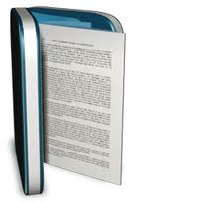
Cloud App
Consumers
NS On-Prem assets

Slide 14
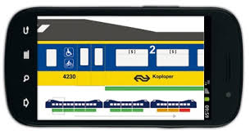
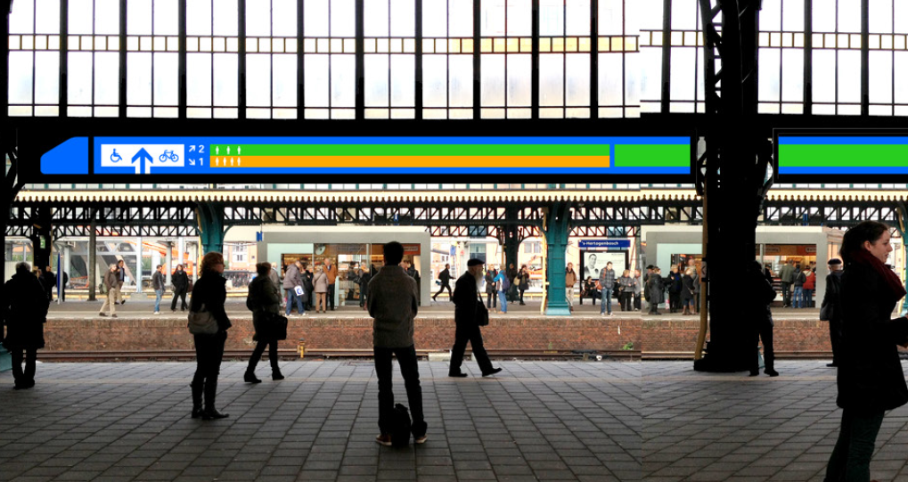
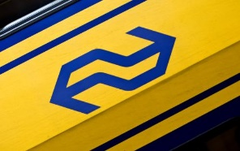
DB
Cache (role-based)
Fast retrieval
Progress Apama
Correlated data
API
Worker
Audit
Web
events
History
Azure VM 2-core
RitInfo & SensorInfo
Storage Queues
REST
Virtual Network
Web
Consumers
RitInfo
SensorInfo

Slide 15
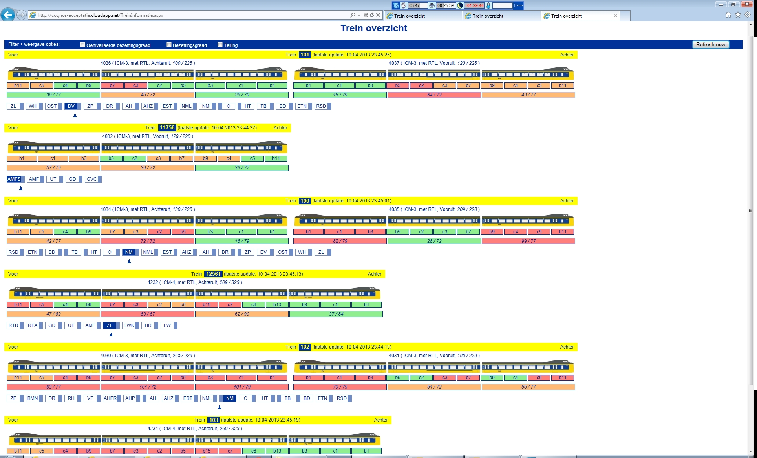

Slide 16
Summary
Strong combination of PaaS and IaaS
Used Cloud Services, Storage (queues, blob and tables), Cache, Virtual Network
Experimented with SQL Database, Reporting, Service Bus, Push Notifications, SignalR
Setting up VPN device can be awkward, take time for it but it was stable for months
Use Cache to speed things up
Experiment and play a lot!
Lot of exposure (NOS journaal) and nominations/awards (TIMMIE award)

